Slide 1

Slide 1
WIFI Fingerprinting
By : Irene

Slide 2
Slide 2
Agenda
Introduction to WIFI fingerprinting
Data Provided
Preprocessing
Results
Conclusion
2

Slide 3
Slide 3
INTRODUCTION TO WIFI FINGERPRINTING
Indoor Positioning System
Receiving Signal Strength (RSS) values
Wireless router is used as the Access Point (AP)
Used triangulation technique to get the training data
Deterministic approach chosen
3

Slide 4
Slide 3
DATA PROVIDED
529 attributes in total
Data provided was of three buildings at a campus
They had 4 to 5 floors each
Each fingerprint differentiated by the 520 WAPs and its RSS value
Intensity values varied from -104dBm(poor signal) to 0dBm (very good signal)
24 different devices were used for the experiment
Longitude and latitude was noted of the points from where the users accessed the WAPs.
4

Slide 5
Slide 3
PRE PROCESSING STAGE
Changed the data type of building and floor to factor
Removed WAPs with only 100 (as 100 denotes WAP not detected) and ones close to -104
Removed rows where 100 was the value for all WAPs
Removed SPACEID, RELATIVE POSITION, USER ID, PHONE ID, TIMESTAMP
Considered 50 percent of the dataset
The same pre-process was done for the validation set
5

Slide 6
Slide 3
EVALUATION
Predicted building with all data
Predicted the floor with the predicted building but it threw an error
Predicted latitude and longitude in the validation set
Used kNN to train all models
Tried to predict on train set itself but got an error
So model trained on training set and tested on validation set
7

Slide 7
Slide 3
RESULT
Trained model with 50 % of the whole data set
Used kNN to run models
First predicted buildings and got an accuracy of 99% where k=5
Predicted the floor where model had an accuracy of 77% (k=5)
With the values above predicted latitude and longitude
Found the distance of the person from the WAP to be around 15.8m (c value)
7

Slide 8
Slide 3
CONCLUSION
Model trained to find the exact location of the person
The distance from WAP was calculated using actual and predicted values of longitude and latitude
Many practical approaches can be made using the model:
Find how devices differ
Find what environment affects
Find how RSSI affect detection
8

Slide 9
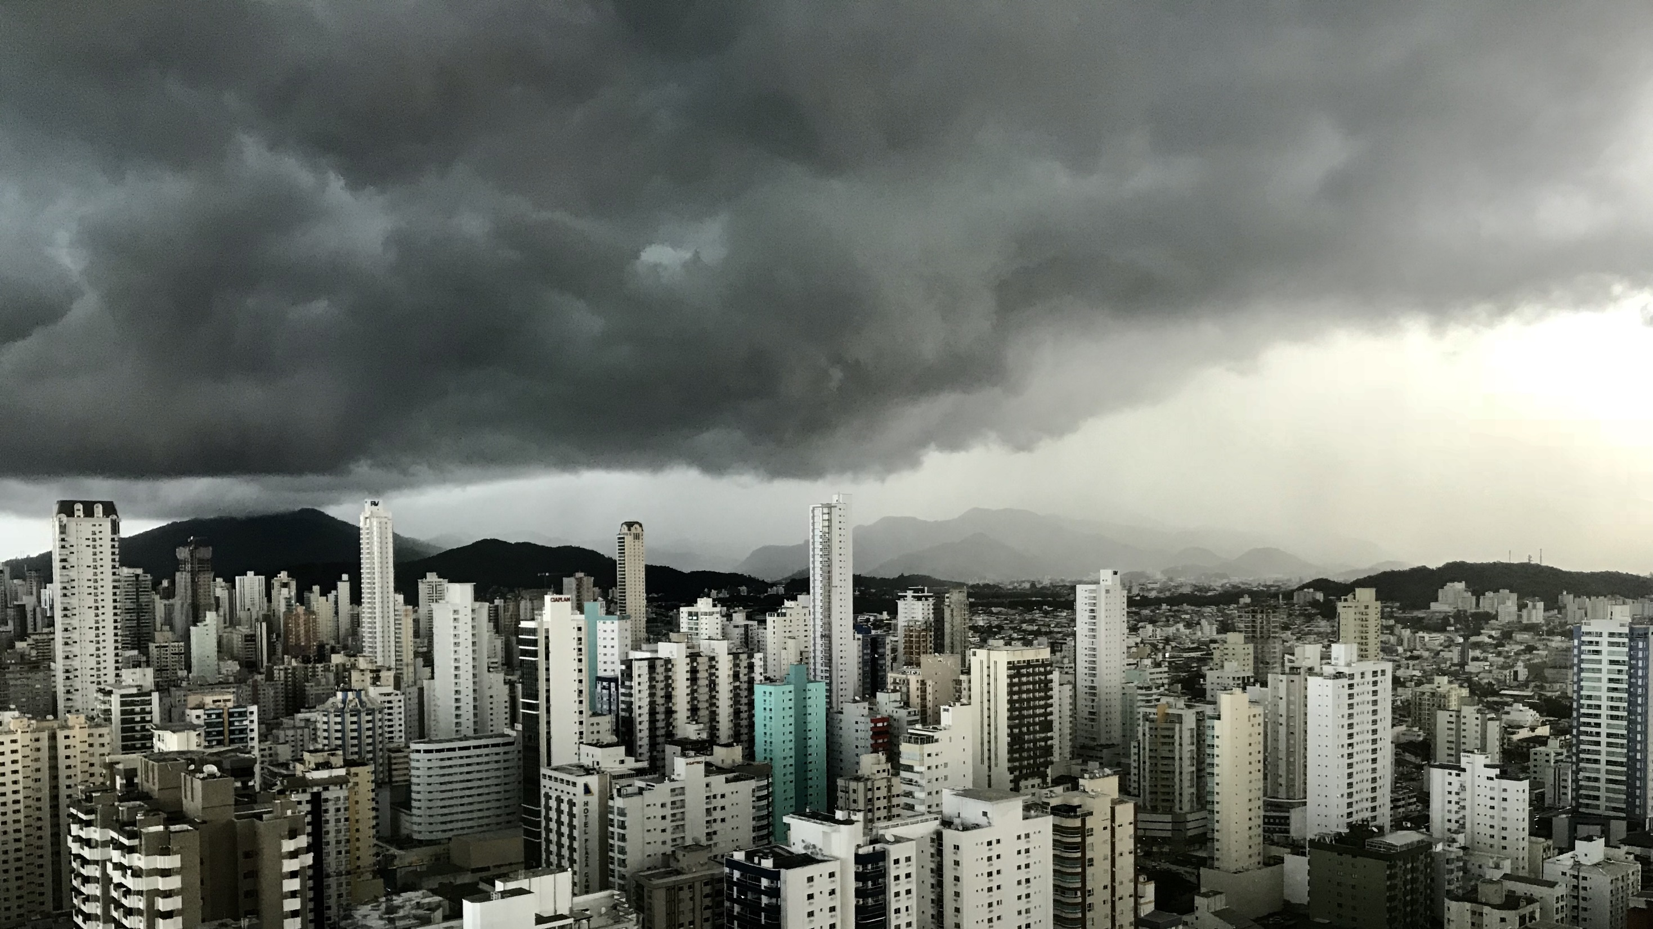
Slide 11
THANK YOU

